Slide 1
True sons of the House
– Walking in covenant
Gen 14 & Dan 3
22/01/17

Slide 2
Treasure relationship (John 17:20-23)
It is costly, don’t break covenantal relationship
²⁰ “I do not pray for these alone, but also for those who will believe in Me through their word; ²¹ that they all may be one, as You, Father, are in Me, and I in You; that they also may be one in Us, that the world may believe that You sent Me. ²² And the glory which You gave Me I have given them, that they may be one just as We are one: ²³ I in them, and You in Me; that they may be made perfect in one, and that the world may know that You have sent Me, and have loved them as You have loved Me.

Slide 3
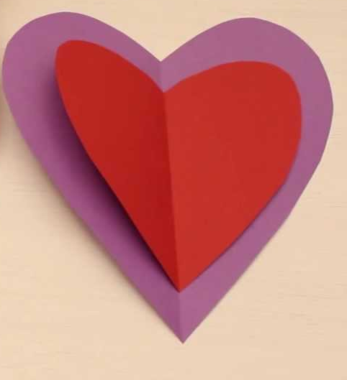


Slide 4
God is hitting RESET – Eccl 12
Remember your creator in the day of your youth
Remember your Creator before your golden bowl is broken
Remember to fear God & keep His commands

Slide 5
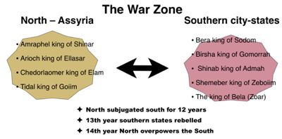
Gen 14:1-12
For 12 years, the South served the North (Chedorlaomer).
In the 13th year, the South rebelled.
In the 14th year, the North defeated the South (Lot captured)

Slide 6
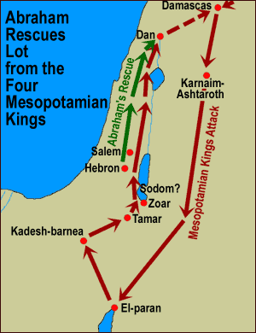
Gen 14:12-24
V14 - Now when Abram heard that his brother was taken captive, he armed his (318) three hundred and eighteen trained servants who were born in his own house, and went in pursuit as far as Dan.

Slide 7
They were walking in covenant
Our covenantal relationship (eternal) has been bought by the blood of Christ
DO NOT break covenantal relationship
*Born and trained

Slide 8
1. They submitted to the same authority
Submitted to Abraham’s authority
Submit to God’s authority (His Word) & appointed authorities (father of the House)
DO NOT rebel

Slide 9

2. They had the same “work”
Same training & same battle
Prov 22:6 - Train up a child in the way he should go, and when he is old he will not depart from it.
Everyone plays a part in the Kingdom!
DO NOT be a spectator only

Slide 10
Spiritual immaturity - Heb 5:12-14
¹²For though by this time you ought to be teachers, you need someone to teach you again the basic principles of the oracles of God. You need milk, not solid food,
¹³for everyone who lives on milk is unskilled in the word of righteousness, since he is a child.
¹⁴But solid food is for the mature, for those who have their powers of discernment trained by constant practice to distinguish good from evil.

Slide 11
2. They had the same “work”
Same training & same battle
Prov 22:6 - Train up a child in the way he should go, and when he is old he will not depart from it.
Everyone plays a part in the Kingdom!
DO NOT be a spectator only

Slide 12
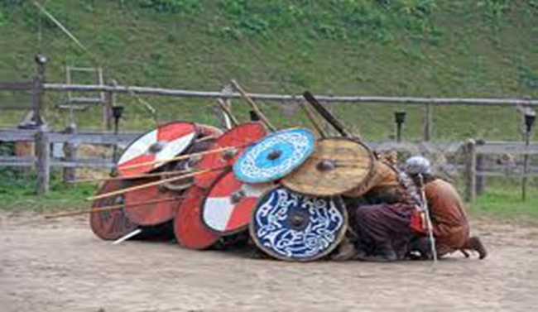
3. They had the same destiny
Going to the same place to fight the same enemy
Eph 6:12 For we do not wrestle against flesh and blood, but against principalities, against powers, against the rulers of the darkness of this age,[a] against spiritual hosts of wickedness in the heavenly places.
Pursue the same course!
DO NOT betray/change

Slide 13
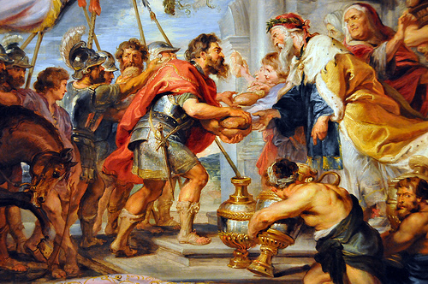
4. They had the same “reward”
Rescue Lot, not gold
“I have raised my hand to the Lord, God Most High, the Possessor of heaven and earth, that I will take nothing…”
DO NOT be greedy for
the world’s treasure
Pursue the spiritual!

Slide 14
Results of Walking in Covenant
They stood together during the trials demonstrating covenantal relationship. Abraham rescued Lot even though he had left him.
Matt 18:20 – When 2 or 3 are gathered together in unity:
i. Miracles happened → victory
- 318 men vs. armies of 4 kings.
ii. Jesus (Melchizedek) appeared

